Slide 2
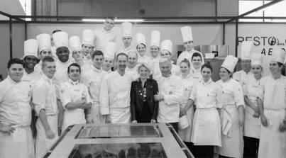
Welcome to EquipHotel 2016
Come and shop for all your professional needs in Paris
As a HORECA professional, you face a number of challenges, day in, day out. EquipHotel acts as your source of inspiration and a means of energizing your development, providing you with access to solutions and helping you meet other market professionals.
Kitchen & Food products
Design & Layout
Bathroom & Spa
IT & Services
EquipHotel 2016, Your must-attend trade show /
#EH16
Discover the programme

Slide 3
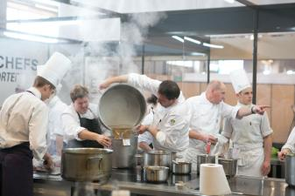
Key figures /
Key figures
111,000 professionals
1,600 exhibitors
133 countries
30 sector of activity
5 days in Paris, France

Slide 4
Benefits offered to group visitors
AMFORHT VIP DELEGATION Guests
Transfers between hotel and EquipHotel (subject to availability)
Classification as VIP visitor
VIP entrance for international visitors (hall 3)
Welcome Pack: Free official catalogue, Left-luggage desk, Business Center access & Concierge services
Permanent access to the VIP Lounge with soft drinks and bar snacks all day
Access to Top Buyers Club including free access to the matchmaking platform EH 360. Save time by matching up with the right suppliers, capable of precisely meeting your needs
EquipHotel Guided Tour including the STUDIO16 with an English-speaking guide (advance booking required)
Paris Hotel Guided Tour (English speaking, advance booking required)
Networking events with EquipHotel’s evening parties
FREE ACCESS
Welcome to EquipHotel 2016 /

Slide 5
Wednesday 9 November 2016
Special AMFORHT day
Welcome to EquipHotel 2016 /

Slide 6
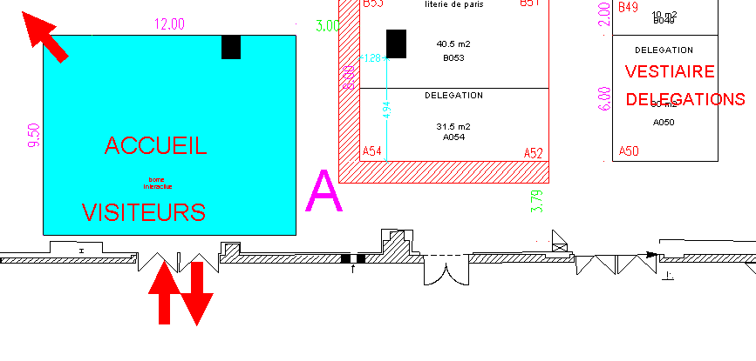
Your day at EQUIPHOTEL
9h15: - Meeting at Pavilion 3, reserved for delegations (one entrance) – prepare your badge
9h30: - Get in EquipHotel 2016 with your individual AMFORHT badge
9h45: - Drop your suitcases and clothes to the Left-luggage desk
- Welcoming words by Corinne MENEGAUX and Philippe FRANCOIS at the delegation area (please see below)
- Official photo of the group in the « Photocall », in the VIP delegation area
- Get your Free EquipHotel’s bag (including Official catalogue, Pocket Guide, Parisian Guide….)
- Start your visit with a short presentation of the show – Audio guide in English
(ID card will be requested as a deposit)
10h30: - Coffee session at VIP area (Hall 7.3) (give back your audio guide)
11h00: - Présentation of the « Studio 16 » area – or free visit
12h30: - Lunch time (ideas page 9)
14h00 - 15h30: - Free Visit to the exhibition (meet the exhibitors)
16h00: - Debriefing at delegation area
18h30: - Networking at the Bar off ( Hall 7.3 free access)
Welcome to EquipHotel 2016 /

Slide 7
Meet some of the exhibitors
Equipement en cuisine :
Ali comenda Pav.7.3 F078
Contact: Stéphane Teboul
Stephane.teboul@freesurf.fr
Tel: +33148216325
Winterhalter Pav.7.3 G23
Contact: Sophie Moritel
sophie.moritel@winterhalter.fr
Tel: +33481767604
Platex Pav.7.3 H047
Contact: Christian Bails
c.bails@platex.com
Tel: +33141929004
Hobart Pav.7.3 H41
Contact: Marie-Hélène Patteeuw
marie.patteeuw@hobart.fr
Tel: +33164116025
Bourgeat Pav.7.3 K067
Contact: Bertrand Dugardin
b.dugardin@vauconsant.com
Tel: +33383458282
Dynamic Pav.7.3 F91
Contact: Ghislaine Gandais
g.gandais@dynamicmixers.com
Tel: +33251630272
Chaîne hôtelière et restauration :
Accor Pav. 7.2 H31
Contact: Anne-Laure Roblot
anne-laure.roblot@accor.com
Tel: +33161616267
Louvre Pav. 7.2 H019
Contact: Marie-Christelle Marville
mcmarville@louvre-hotels.com
Tel: +33142914835
Best Western Pav. 7.2 j47
Contact: Maud Lalande
maud.delalande@bestwestern.fr
Tel: +33149020028
Courtepaille Pav. 7.2 j31
Contact: Julien Raulin
j.raulin@courtepaille.com
Tel: +33169475872
Logis Pav. 7.2 h47
nnoinski@logishotels.com
Contact: Nathalie Noinski
Tel: +33145847000
Bistrot du Boucher Pav. 7.2 k070
Marlène Vele
m.vele@la-boucherie.fr
Tel: +33241966595
Ecole Hôtelière et Restauration:
Ecole Ferrandi Pav.7.3 J126
Contact: Françoise Merloz
fmerloz@ferrandi-paris.fr
Tél: +33149541774
Ecole Ferrières Pav.7.2 F006
Contact: Marc Hofer
marc.hofer@ferrieres-paris.com
Tel: +33181167777
Welcome to EquipHotel 2016 /

Slide 8
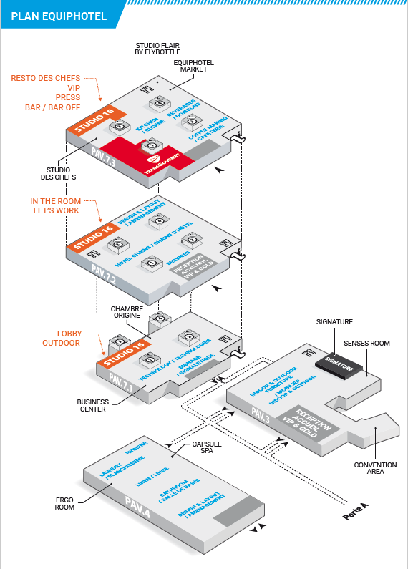
Floor plan EquipHotel

Slide 9
Lunch time Ideas
/// MASQMENOS – PAVILLON 3
Real small meals in Spanish in mini-portions at share all day!
/// BAR À CHAMPAGNE – PAVILLON 3
Enjoy a glass of champagne around different appetizer!
/// RAYM’S BAR – PAVILLON 4
Raym's Bar invites you to taste wines accompanied by a selection of cold meats and cheese
/// MAISON DE L’AUBRAC – PAVILLON 7.1
Discover the specialties of Aubrac. The burgers OBOE from the farms of Aubrac, certified Bleu Blanc Coeur
/// FOOD COURT – PAVILLON 7.2
KIOSQUE GIRAUDET
Discover recipes revisited the soup bar & dumplings giraudet; and enjoy hot chocolate house
HUITRERIE BADETS
The tradition of seafood, sharing the heart of the show, with guests, in a friendly atmosphere!
MAMA ROMA
Modern pizza recipes, typical Italian products ,!
/// QUALITE & CO – PAVILLON 7.2
Healthy products served with passion and attention, takeaway or lunch.
/// APM – PAVILLON 7.3
L’APM is a Parisian bistro with a traditional menu and varied.
/// CAFE PELICAN – PAVILLON 7.3
Alexis Braconnier and his team wake your papillae with Mediterranean food, fresh cooking
/// OTHERS…..
• Pavillon 3 : Paul, Café de seine
• Pavillon 4 : Japan Daily, Eccellenza, Paul
• Pavillon 7.1 : Café de seine
• Pavillon 7.2 : BAR du STUDIO16
Welcome to EquipHotel 2016 /

Slide 10
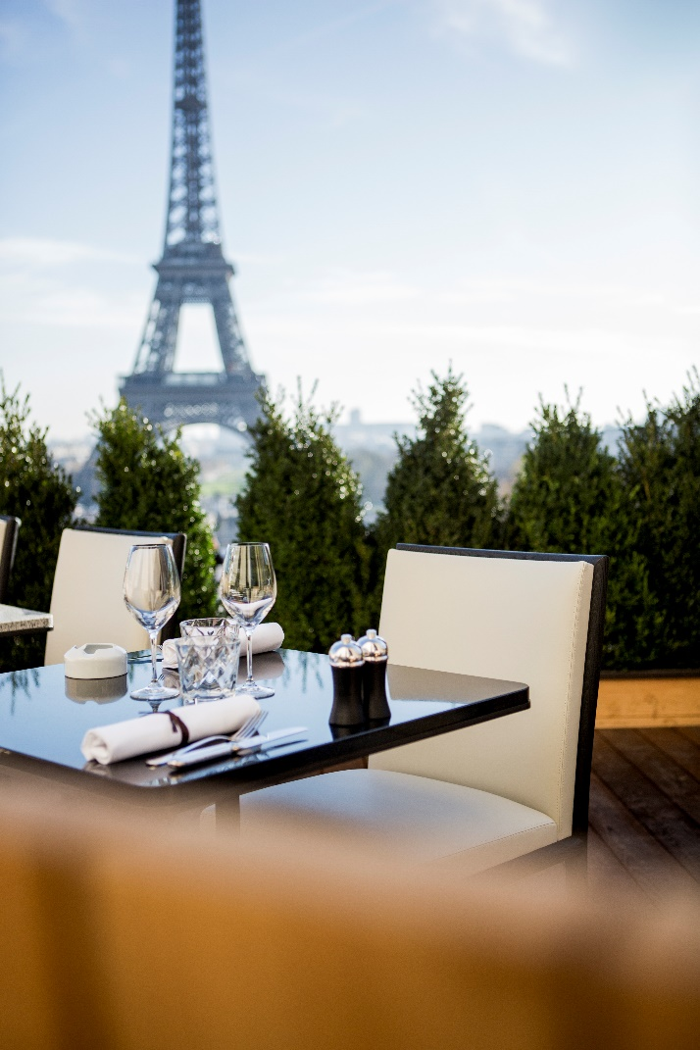
Outside EquipHotel…lunch or dinner time ideas in Paris
/// Café de l’Homme
Enjoy an unobstructed view of the Eiffel Tower in a relaxed setting.
Discover recipes that reinterpret the culinary identity of the restaurant -seasonal creations, devotion to regional influences and an unquenchable desire to offer original and inspiring tastes.
The combination of tradition and exceptional produce creates a cuisine that marries simplicity with sophistication.
A glass champagne Charles Heidsieck Brut Réserve will be offered to AMFORHT Member (just mention your AMFORHT membership when reserving)
www.cafedelhomme.com
17 place du Trocadéro 75016 Paris
Tel : +33 (0)1 44 05 30 15
Welcome to EquipHotel 2016 /

Slide 11
Events at Equip’Hotel
WEDNESDAY
The Studio des Chefs Pav.3
10h – Final competition « la Restauration Collective au féminin »
Capsule Spa Pav.4
11h - The spa barometer 2016
Let’s work area Pav 7.2
12h – Awards of Lauriers Ecorismo
Initiative on sustainable development solutions by Philippe FRANCOIS
The Studio des Chefs Pav.3
13h – « Etape IDF de Garguanta »
The Studio Flair by Flybottle Pav 7.3
14h-17h – French Flair Bartenting Championship 2016
The Studio Flair by Flybottle Pav 7.3
17h00-17h30 – Announcement of winners of « French Flair Bartending Championship »
The Resto des Chefs Pav 7.3
19h – Collectivity evening
Welcome to EquipHotel 2016 /
To DISCOVER also …
Ergo room capsule
Sense room capsule
Spa capsule
Origine capsule

Slide 12
Reminder… your AMFORHT VIP advantages
Free access for 5 days with VIP badge
Dedicated VIP entrance
Left-luggage desk free of charge for 5 days
Unlimited access to VIP area (include beverage)
Opportunity to sample the EH “Religieuse” in the VIP lounge
Free Official Catalogue (under availability)
Access to the Studio VIP and the Bar OFF
Free shuttles from/ to the airport to EquipHotel
Welcome to EquipHotel 2016 /

Slide 13
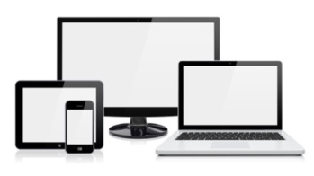
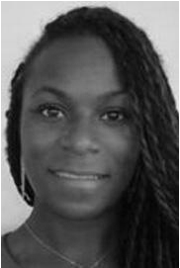
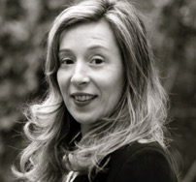
Follow us
Save the date
06 -10 November 2016 1 Place de la Porte de Versailles 75015 Paris, France
Opening hours Sunday to Wednesday : 9.30am to 7.00pm Thursday : 9.30am to 6.00pm
www.equiphotel.com
Contact @EquipHotel
EquipHotel Paris
Lindsay JOACHIM International Partners contact & Delegation coordination lindsay.joachim@reedexpo.fr +33 1 47 56 51 19
EquipHotel 2016, Paris, France /
#EH16
Contact @ AMFORHT
Helene VERDET AMFORHT General Delegate helene.verdet@amforht.com +33 7 61 05 74 65
@equiphotelparis

